Slide 1
Hierarchical Clustering

Slide 2
Introduction
Hierarchical clustering is another unsupervised machine learning algorithm, which is used to group the unlabeled datasets into a cluster and also known as hierarchical cluster analysis or HCA.
hierarchy of clusters in the form of a tree, and this tree-shaped structure is known as the dendrogram.
Why
A predetermined number of clusters,
It always tries to create the clusters of the same size.

Slide 3
Approaches
Agglomerative: Agglomerative is a bottom-up approach, in which the algorithm starts with taking all data points as single clusters and merging them until one cluster is left.
Divisive: Divisive algorithm is the reverse of the agglomerative algorithm as it is a top-down approach.

Slide 4
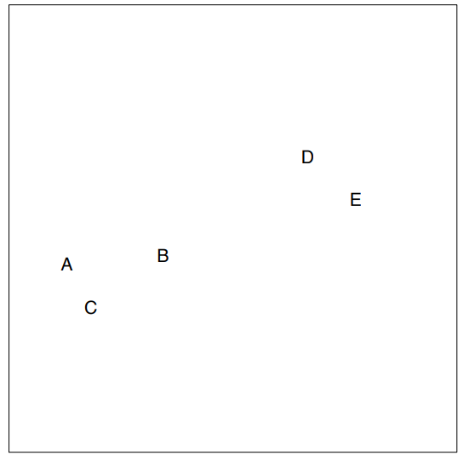
Agglomerative Hierarchical clustering
Step-1: Create each data point as a single cluster. Let's say there are N data points, so the number of clusters will also be N.

Slide 5
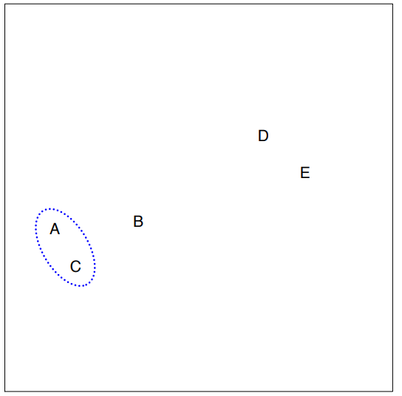
Step-2: Take two closest data points or clusters and merge them to form one cluster. So, there will now be N-1 clusters.

Slide 6
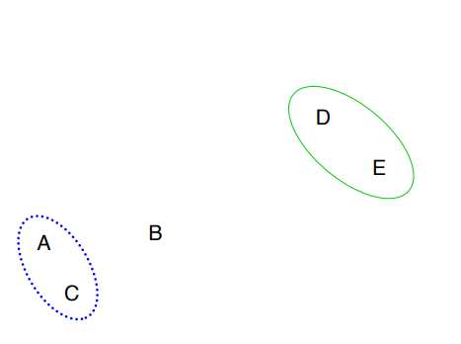
Step-3: Again, take the two closest clusters and merge them together to form one cluster. There will be N-2 clusters.

Slide 7
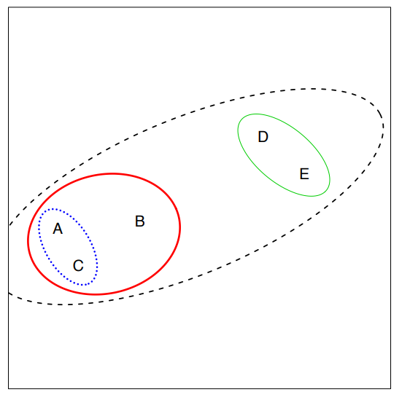
Step-4: Repeat Step 3 until only one cluster left. So, we will get the following clusters.

Slide 8
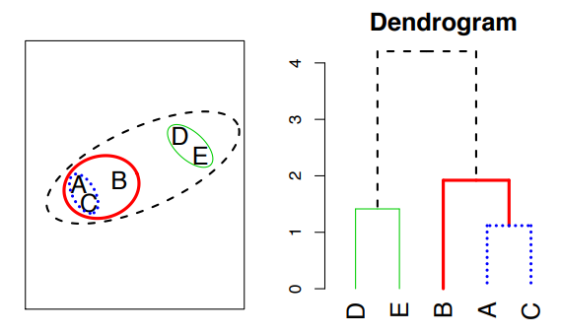
Result

Slide 9
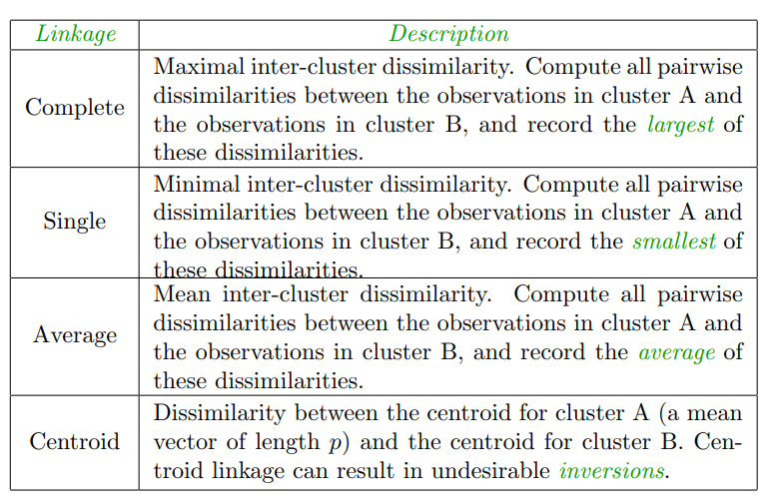
Linkage Measure/ Measure for the distance between two clusters

Slide 10
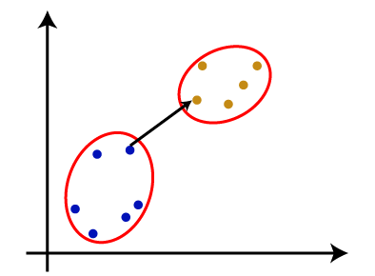
Single Linkage
It is the Shortest Distance between the closest points of the clusters.

Slide 11
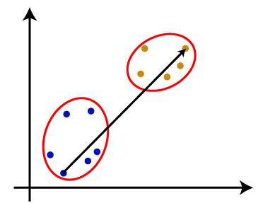
Complete Linkage
It is the farthest distance between the two points of two different clusters. It is one of the popular linkage methods as it forms tighter clusters than single-linkage.

Slide 12
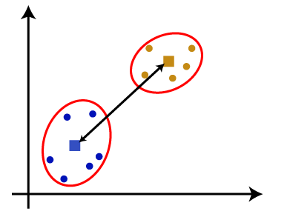
Average Linkage: It is the linkage method in which the distance between each pair of datasets is added up and then divided by the total number of datasets to calculate the average distance between two clusters. It is also one of the most popular linkage methods.
Centroid Linkage: It is the linkage method in which the distance between the centroid of the clusters is calculated. Consider the below image:

